Slide 1
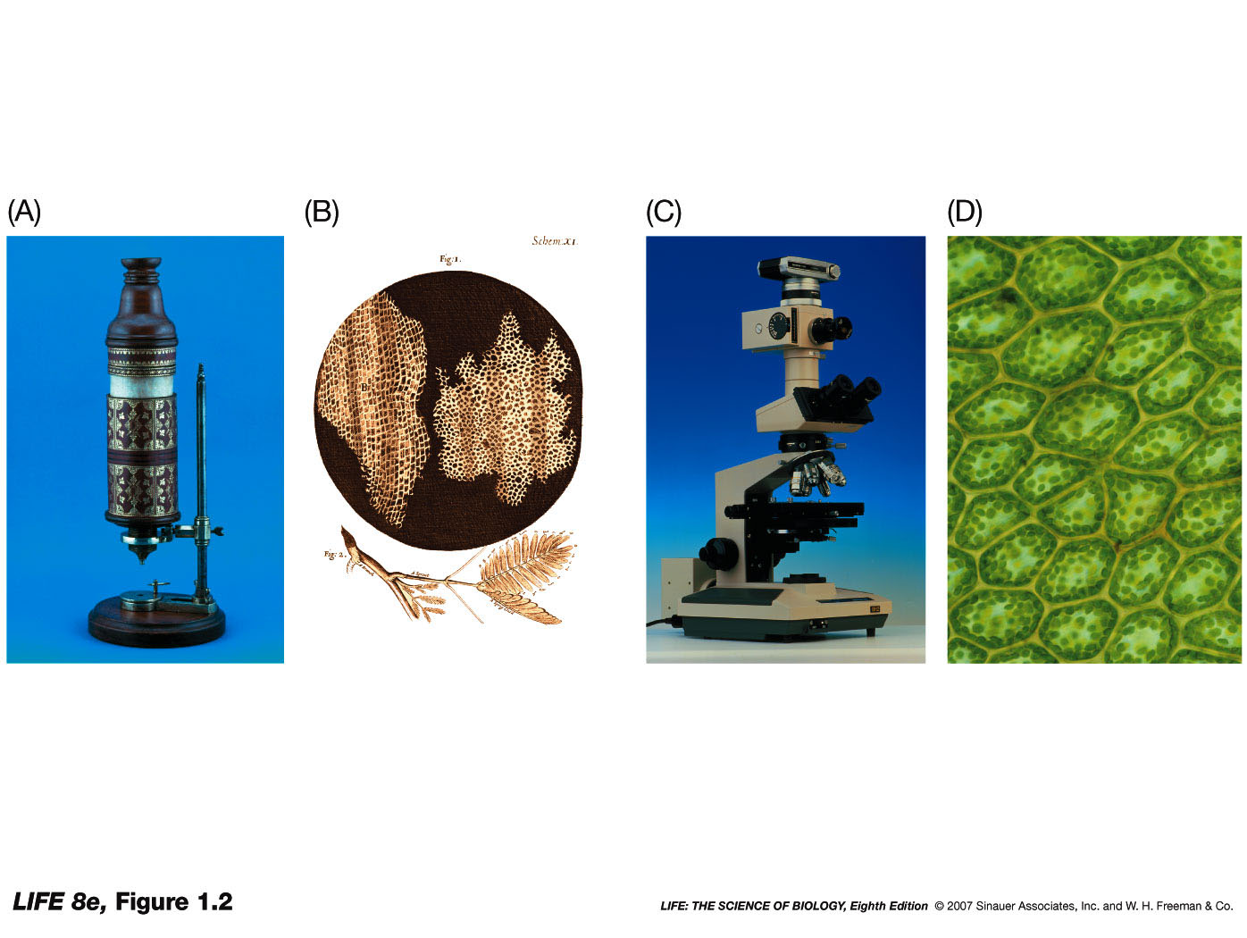
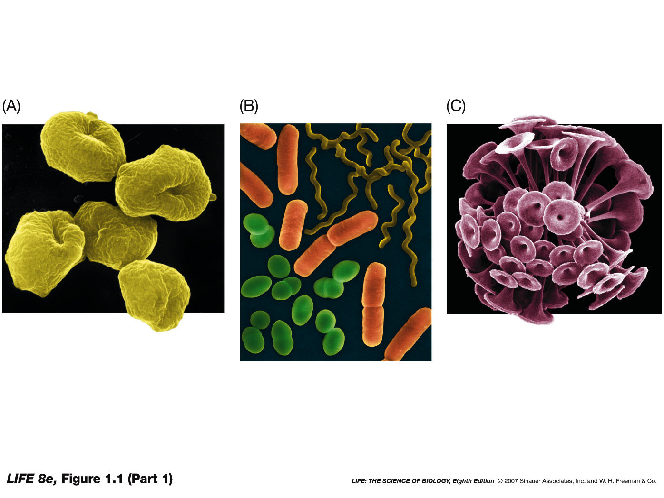
Intro to Biotechnology
Lect. 2
Zaccharias & Hans Janssen
1590
Leeuwenhoek & Hooke
mid-late 1600s
Cell Theory:
Schwann & Schleiden
1838
1.
2.
3.
Synthetic biology – basic components of a cell?

Slide 2
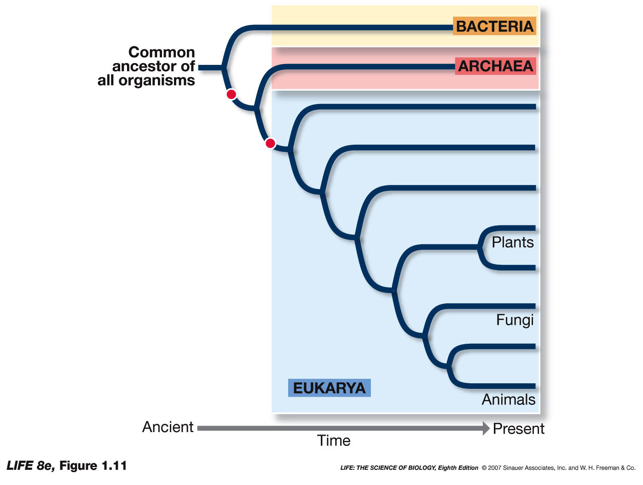
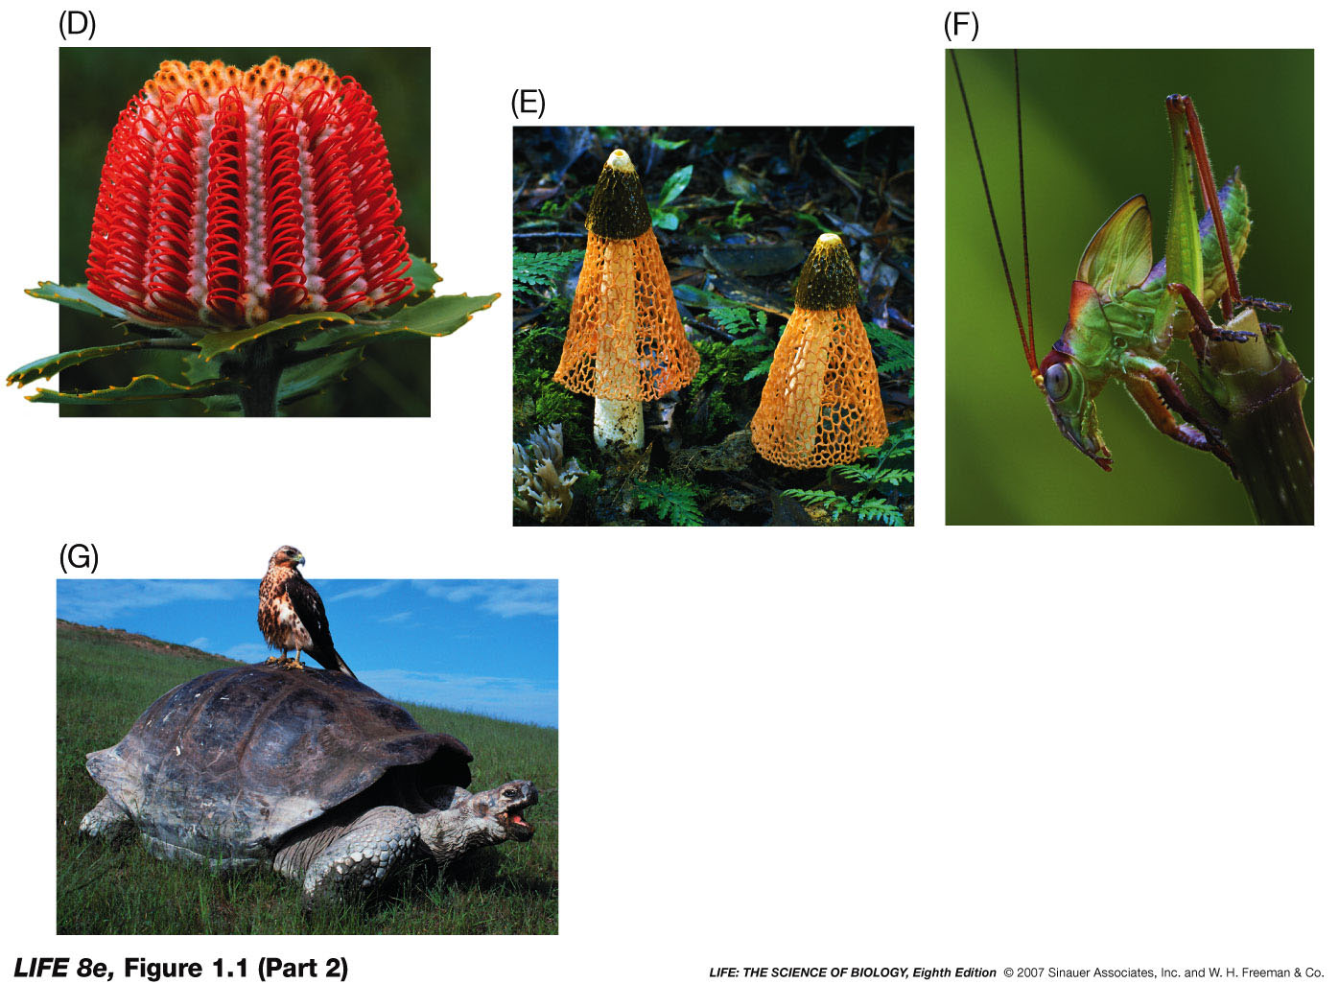
Intro to Biotechnology
Lect. 2
Basic components of a cell?
3 domain system:
“Prokaryotic”
vs
Eukaryotic
Differences?
Bacteria
Archaea
Extremophiles (biotech…)
-
-
-
-

Slide 3
Intro to Biotechnology
Lect. 2
Basic components of a cell?
Prokaryotic
vs
Eukaryotic
Differences?

Slide 4
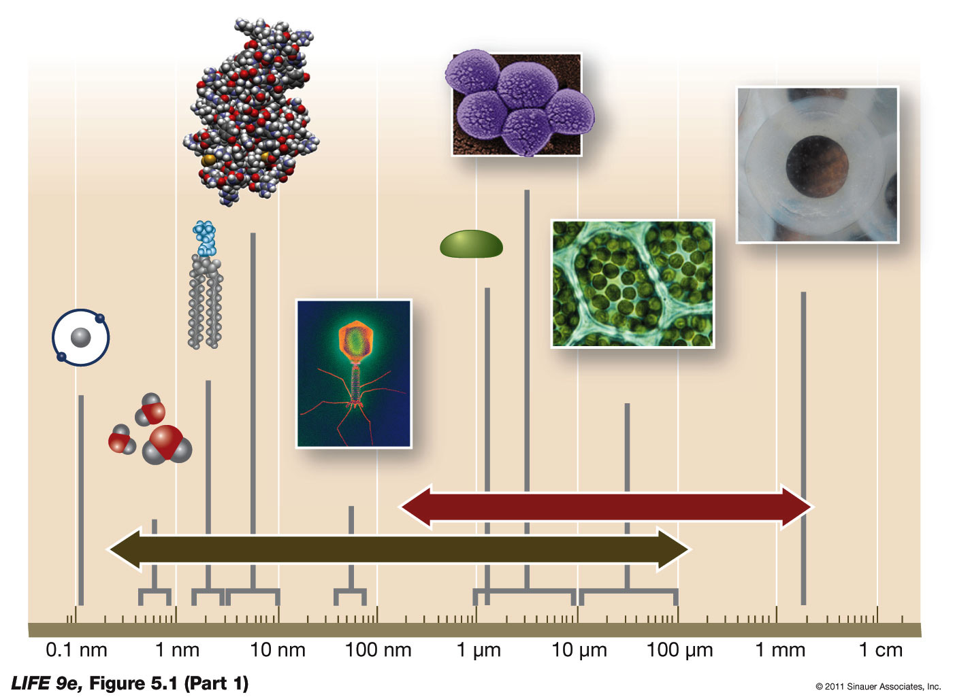
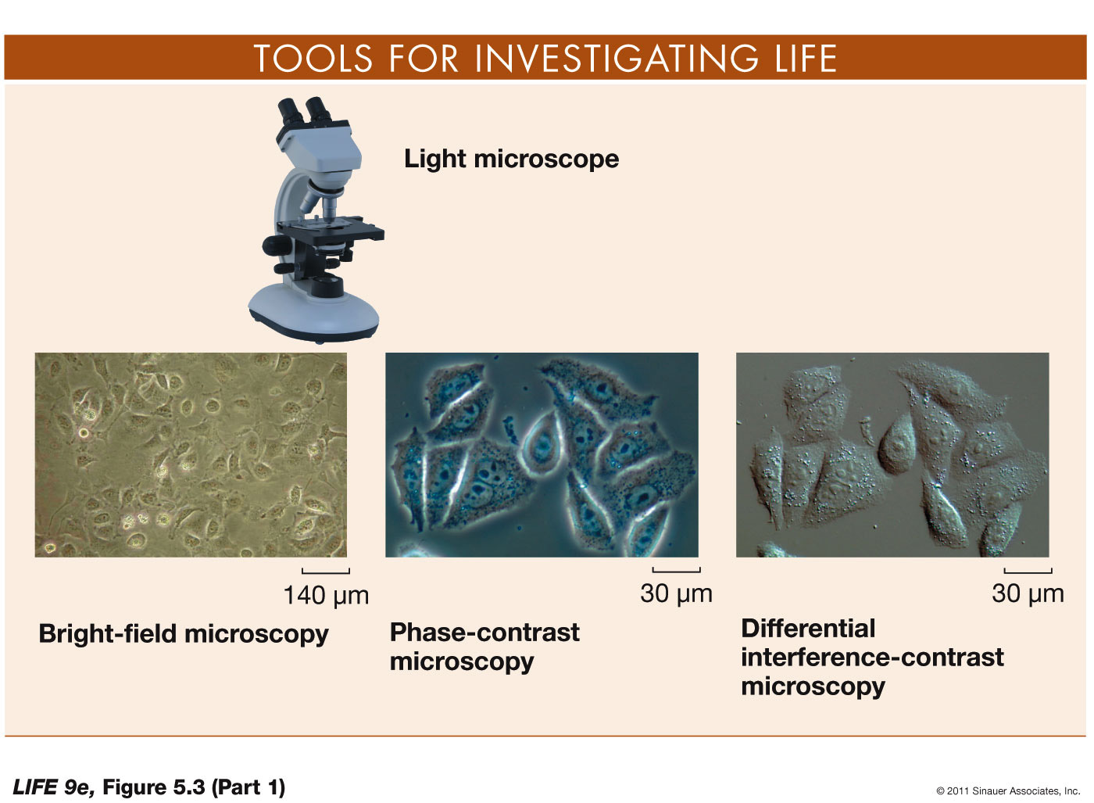
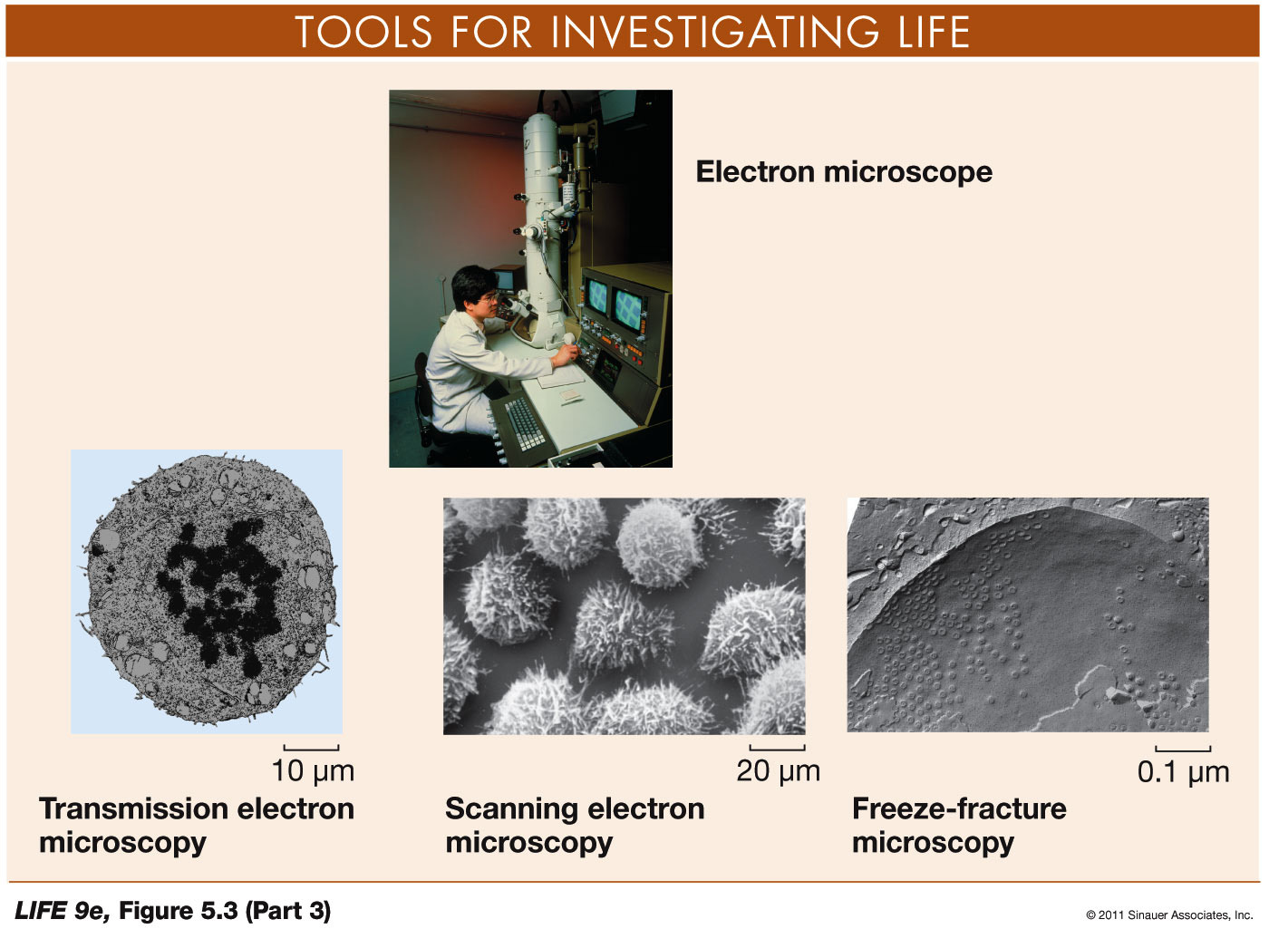
Intro to Biotechnology
Lect. 2
Scale: 1-100um
Visualization:
bright field, phase contrast, DIC
fluorescence, confocal
- Electron (transmission, scanning)

Slide 5
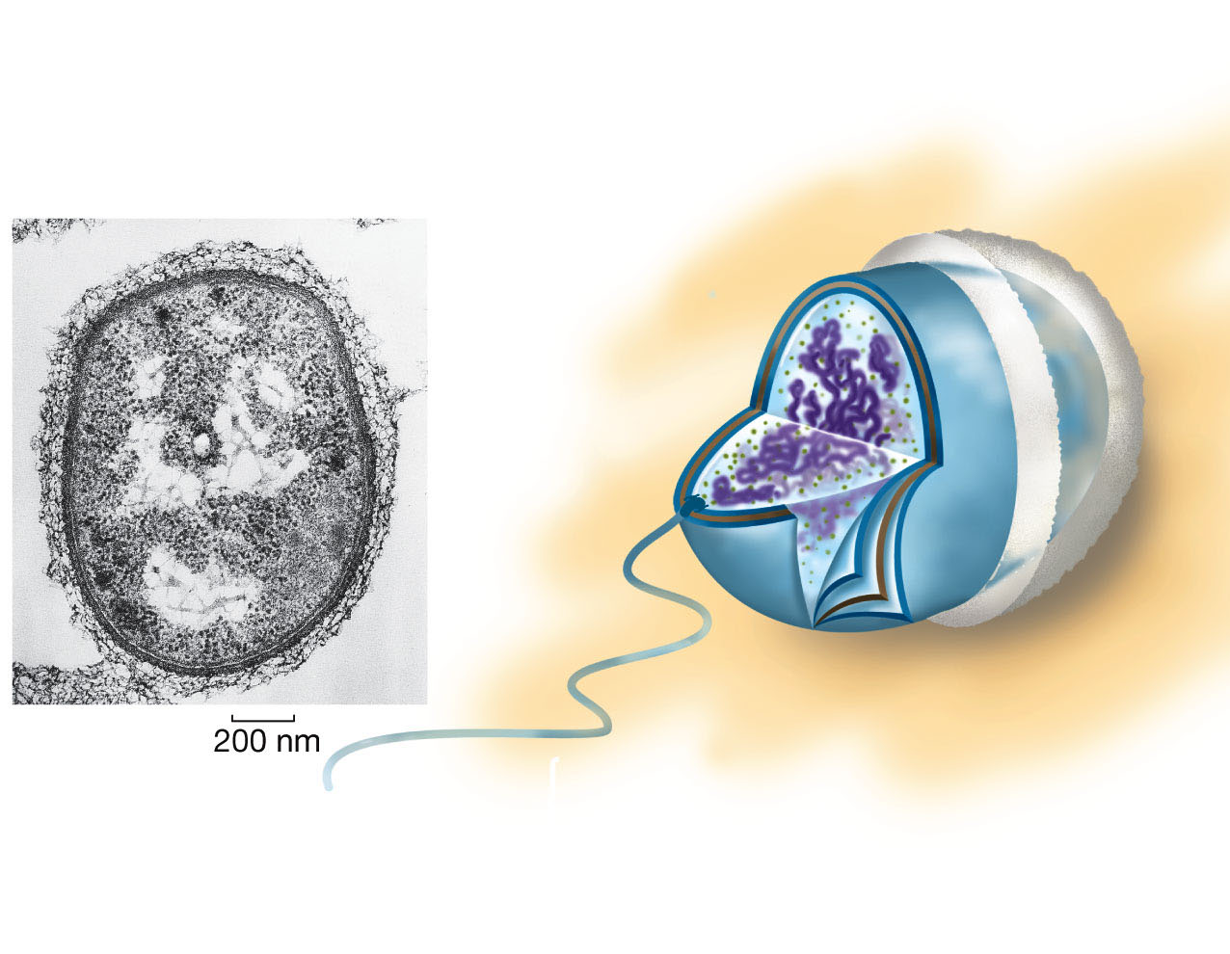
Intro to Biotechnology
Lect. 2
Basic components of a prokaryotic cell?
Capsule
Cytoplasm
Peptidoglycan
Outer membrane
(absent in some bacteria)

Slide 6
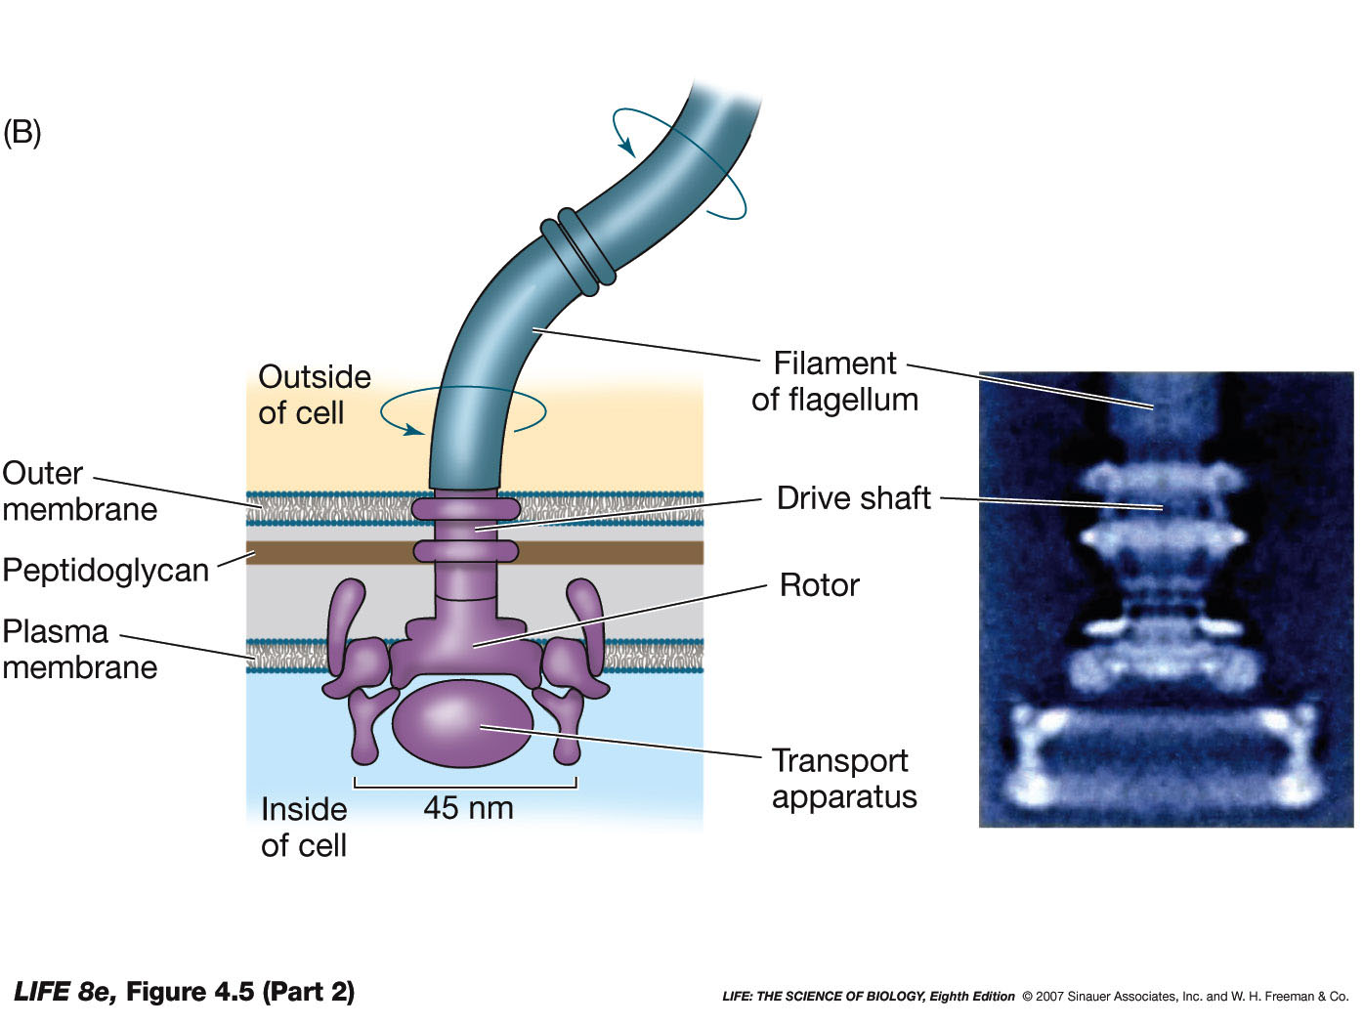
Intro to Biotechnology
Lect. 2
Basic components of a prokaryotic cell?
Flagellum
Bacterial:
- H.pylori
• 4-6 flagella
• ulcers, cancer
• 50% infected
• 80% asymptomatic
• transmission?
• Warren & Marshall
observed 1979
cultured 1982
drank – gastritis
triple treatments
Nobel 2005
Archaeal:
- like pili
Eukaryotic: sperm

Slide 7
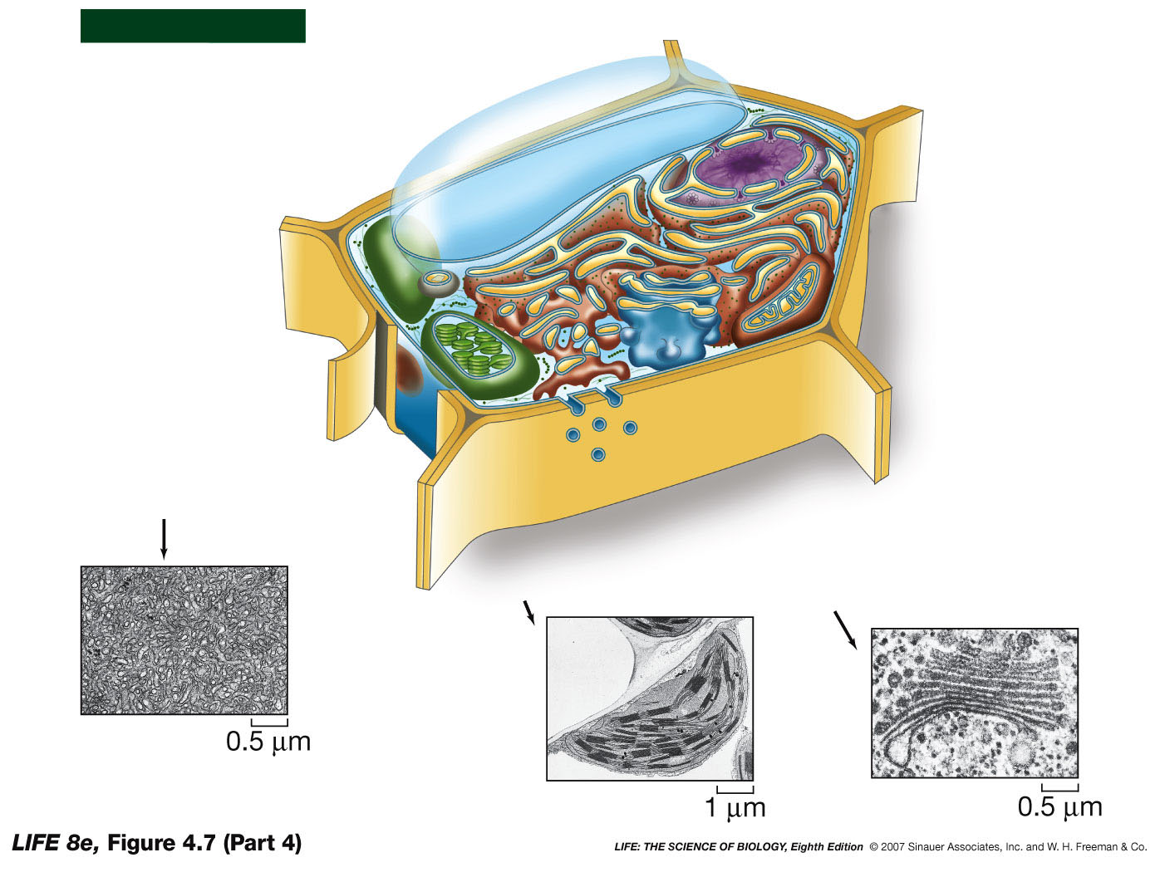
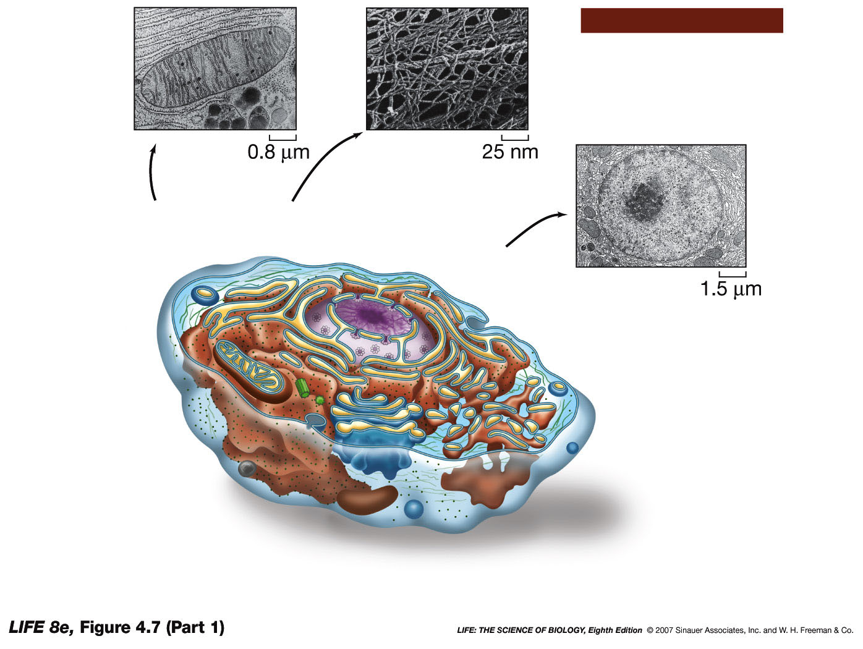
Figure 4.7 Eukaryotic Cells (Part 1)
Intro to Biotechnology
Lect. 2
Eukaryotic
plant
animal
Similarities/Differences?

Slide 8
Figure 4.7 Eukaryotic Cells (Part 1)
Intro to Biotechnology
Lect. 2
Animal Cell
Free ribosomes
Smooth
endoplasmic
reticulum
Ribosomes
(bound to RER)
Plasma
membrane

Slide 9
Intro to Biotechnology
Lect. 2
A PLANT CELL
Free
ribosomes
Nucleus
Rough
endoplasmic
reticulum
Smooth
endoplasmic
reticulum
Plasma
membrane
Mitochondrion
Golgi apparatus

Slide 10
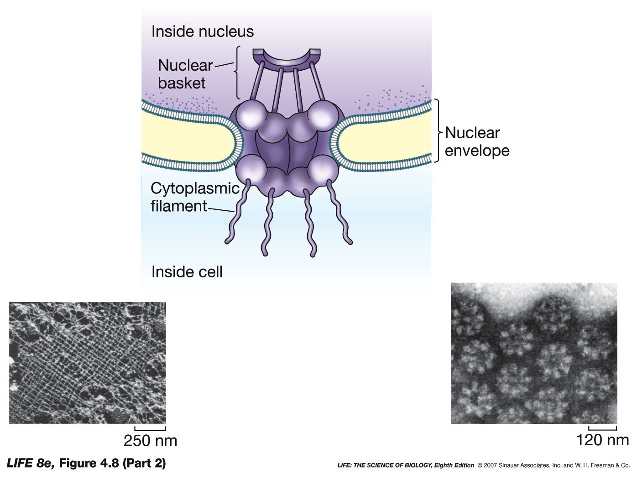
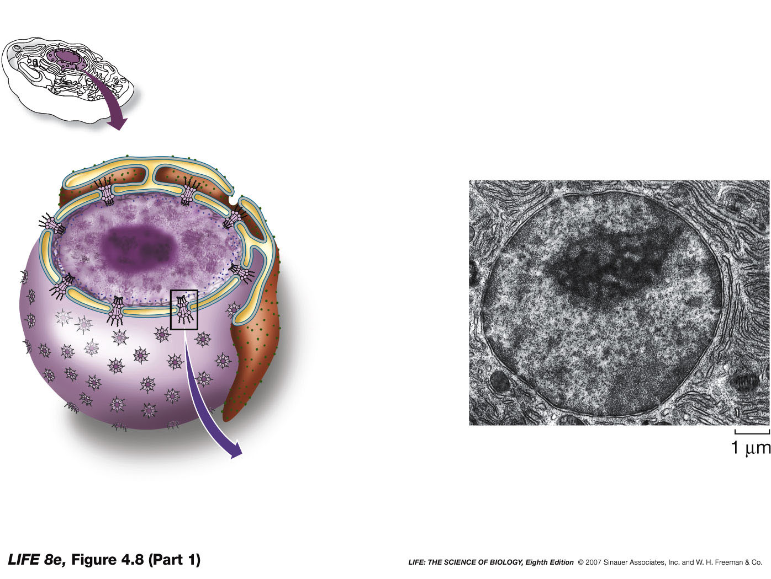
Intro to Biotechnology
Lect. 2
Eukaryotic cells – similarities
1. Nucleus
Outer membrane
Nucleoplasm
Inner membrane
Nucleolus
Nuclear
lamina
Nuclear
envelope
Nuclear
pore

Slide 11
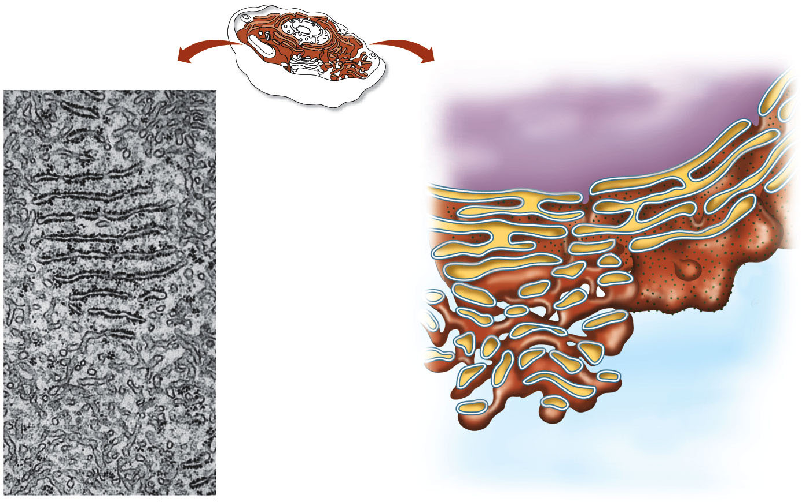
Intro to Biotechnology
Lect. 2
Eukaryotic cells – similarities
1. Endoplasmic reticulum
a.
Nucleus
Rough Endoplasmic
Reticulum
Ribosomes
Smooth Endoplasmic
Reticulum
Lumen

Slide 12
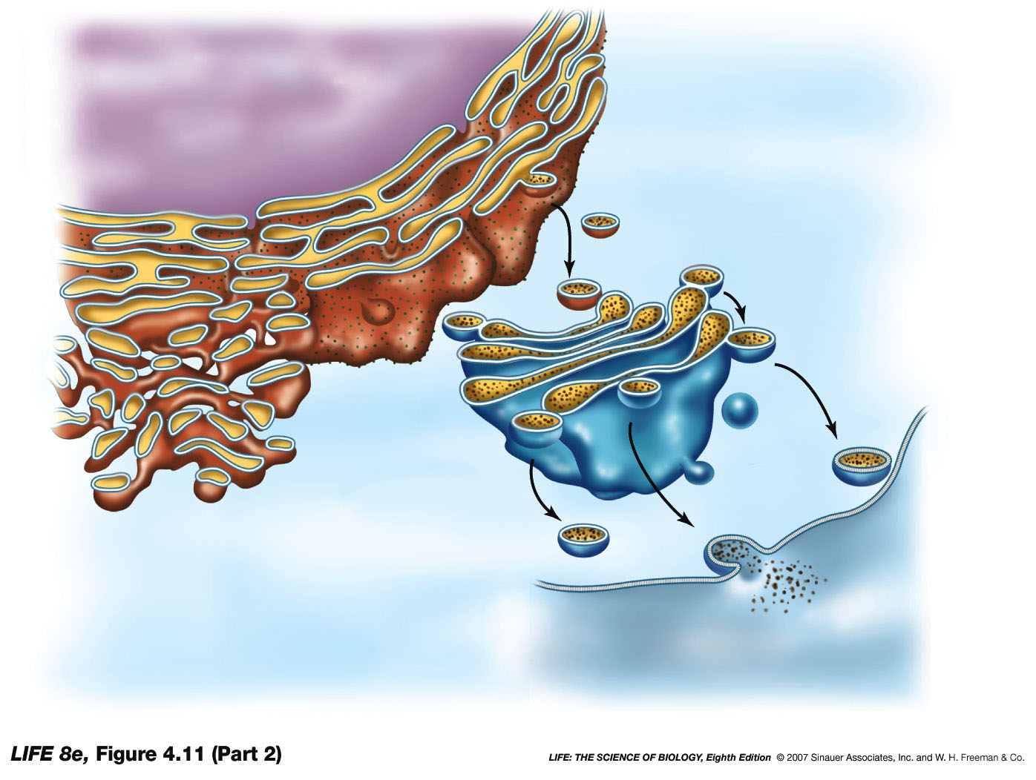
Intro to Biotechnology
Lect. 2
Eukaryotic cells – similarities
2. Golgi apparatus
Nucleus
ER
Golgi apparatus
cis
region
medial
region
trans
region
Plasma membrane

Slide 13
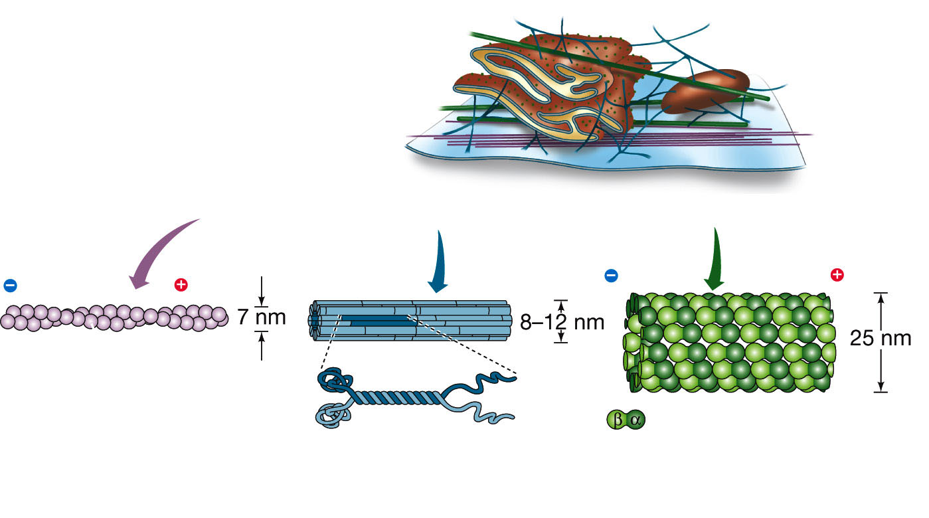
Intro to Biotechnology
Lect. 2
Eukaryotic cells – similarities
3. cytoskeleton
Plasma
membrane
End
End
End
End
Actin monomer
Fibrous subunit
Tubulin
dimer
β-Tubulin
monomer
α-Tubulin
monomer

Slide 14
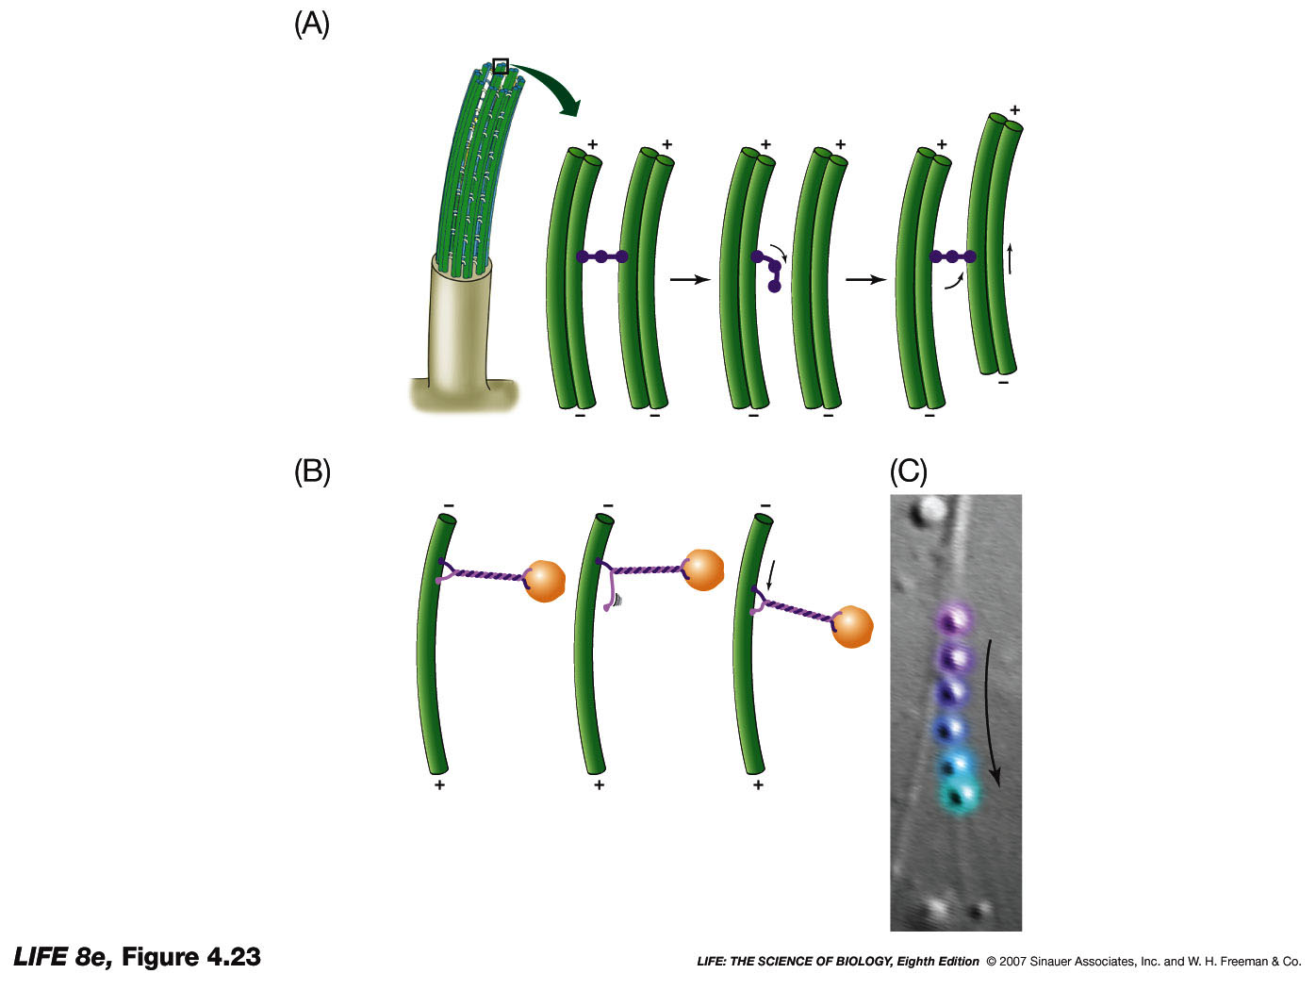
Intro to Biotechnology
Lect. 2
Eukaryotic cells – similarities
3. cytoskeleton
f. Molecular transport
Microtubule

Slide 15
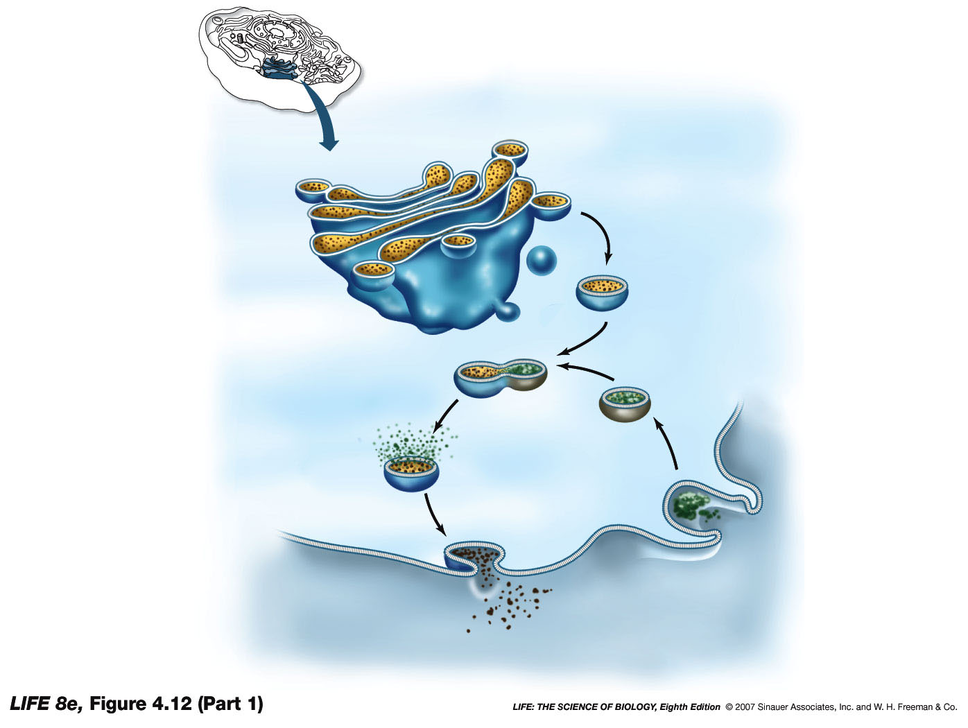
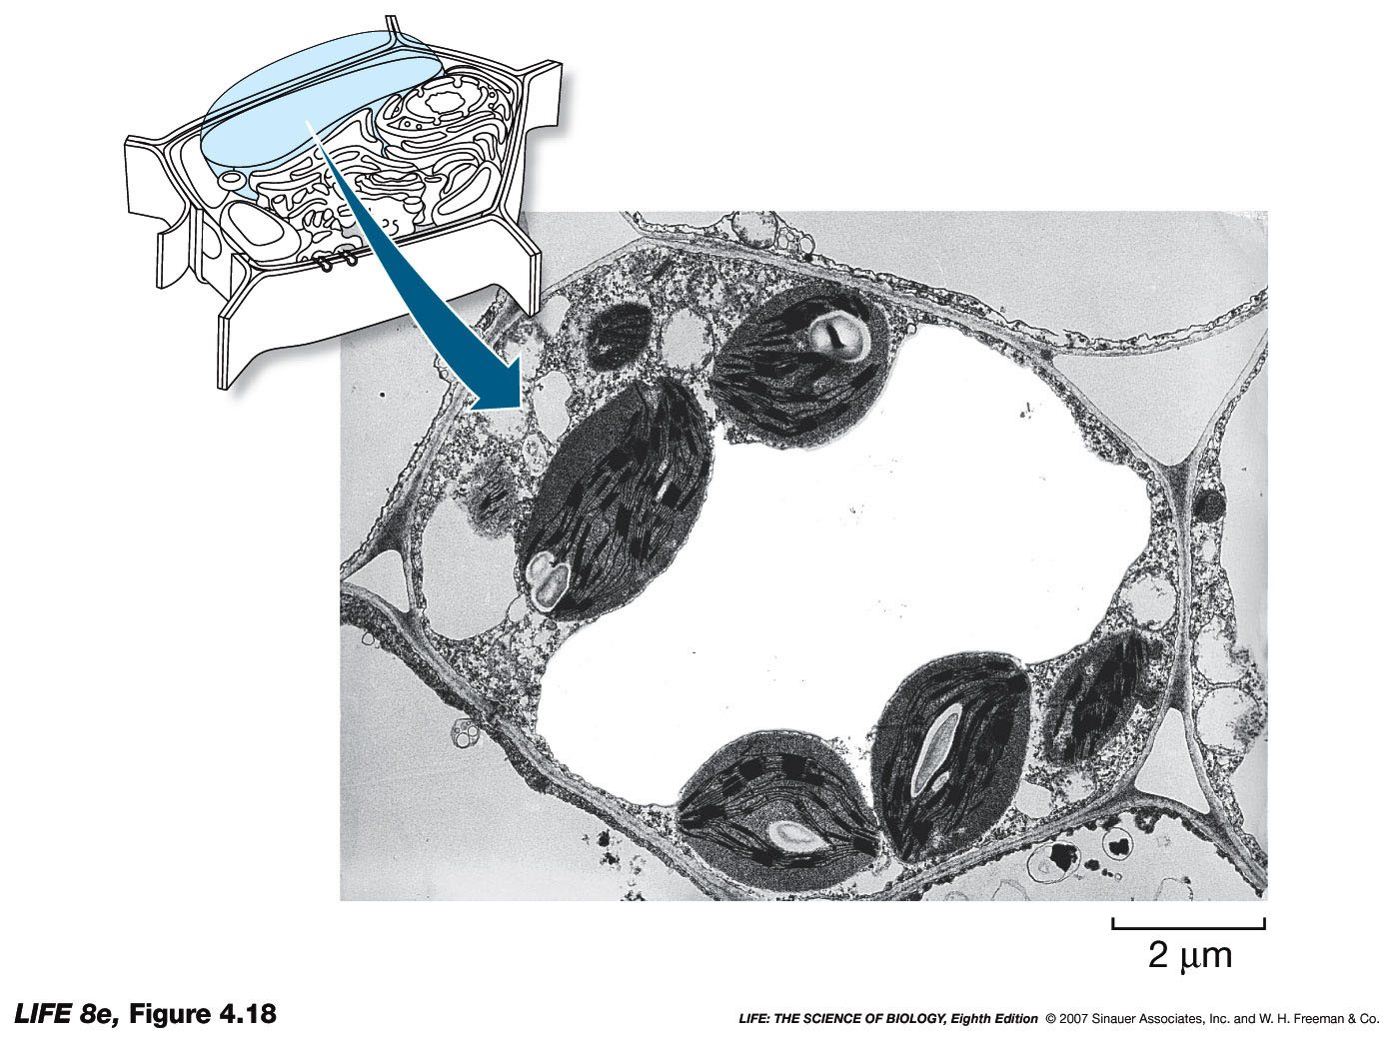
Intro to Biotechnology
Lect. 2
Eukaryotic cells – differences
1. Lysosomes vs vacuoles
-
Golgi
apparatus
Plasma
membrane
Outside of cell
2. Peroxisomes vs glyoxysomes
3. Mitochondria vs chloroplasts

Slide 16
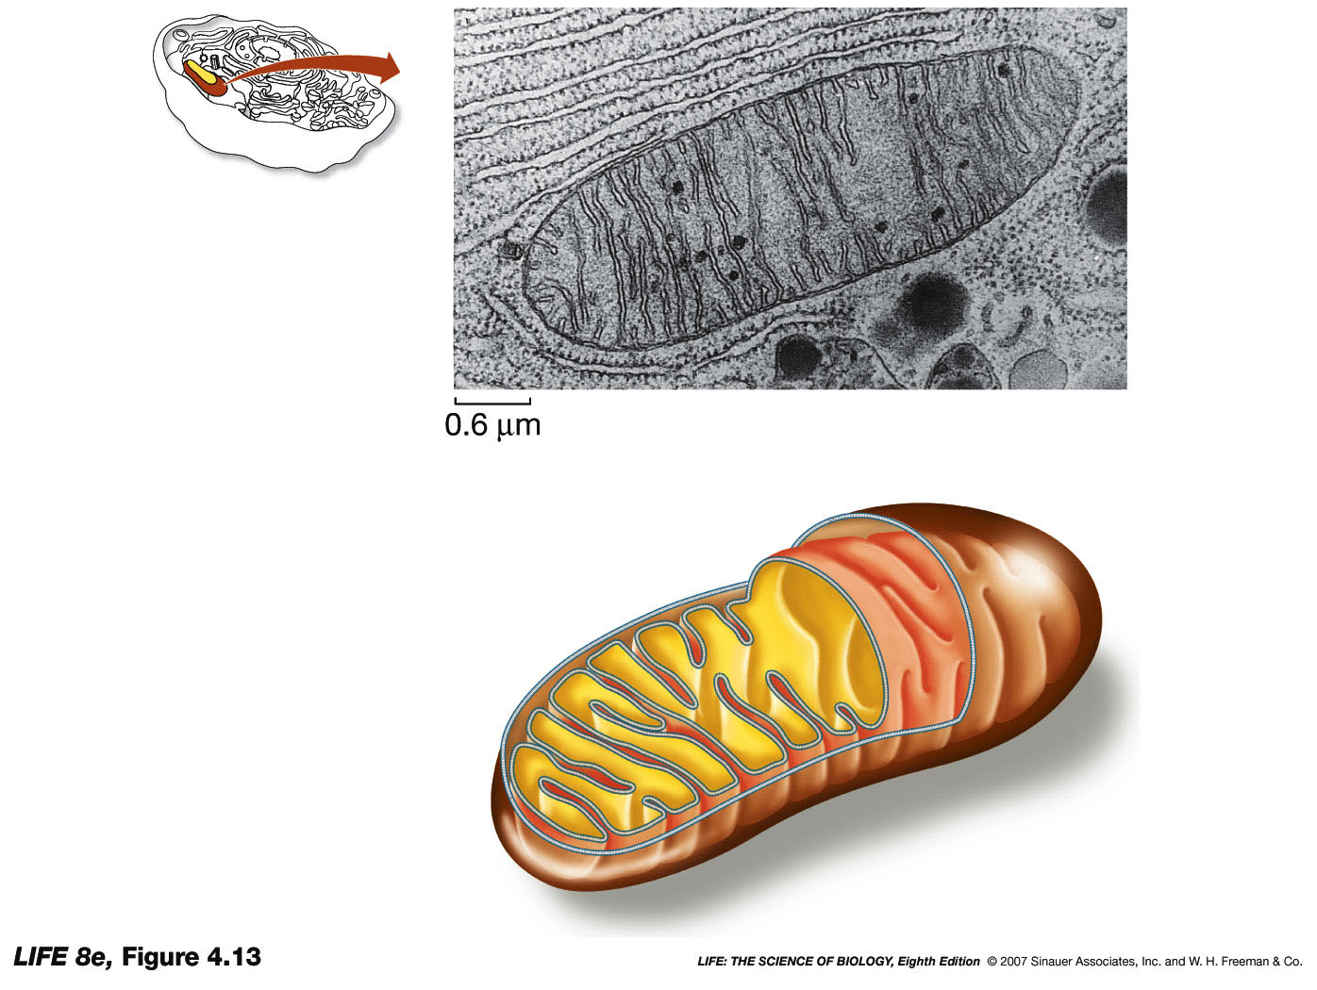
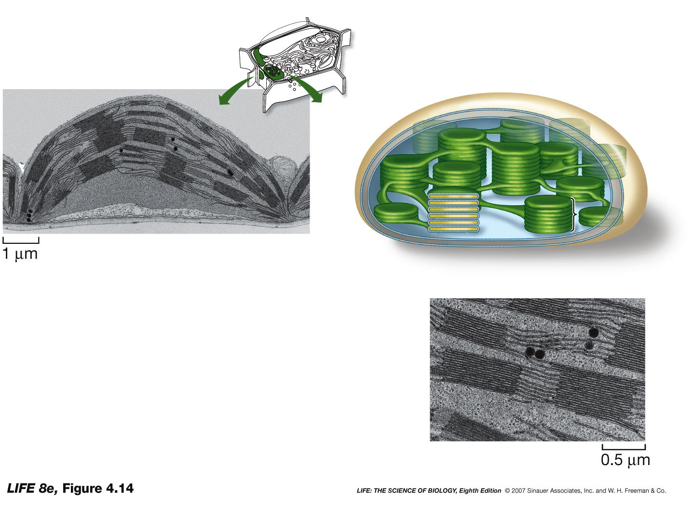
Intro to Biotechnology
Lect. 2
Eukaryotic cells – differences
3. Mitochondria vs plastids (e.g. chloroplasts)
-
Matrix
Thylakoid
Stroma
Cristae

Slide 17
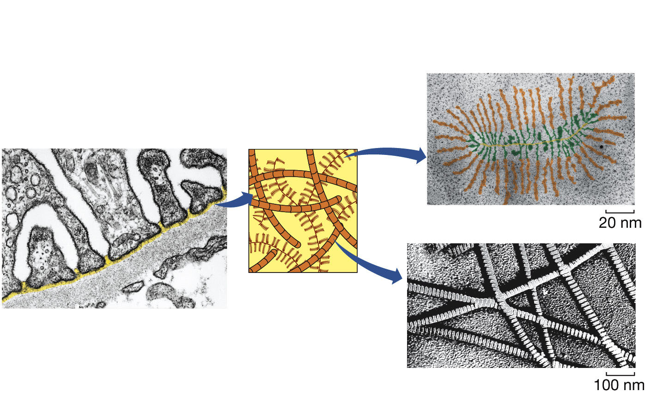
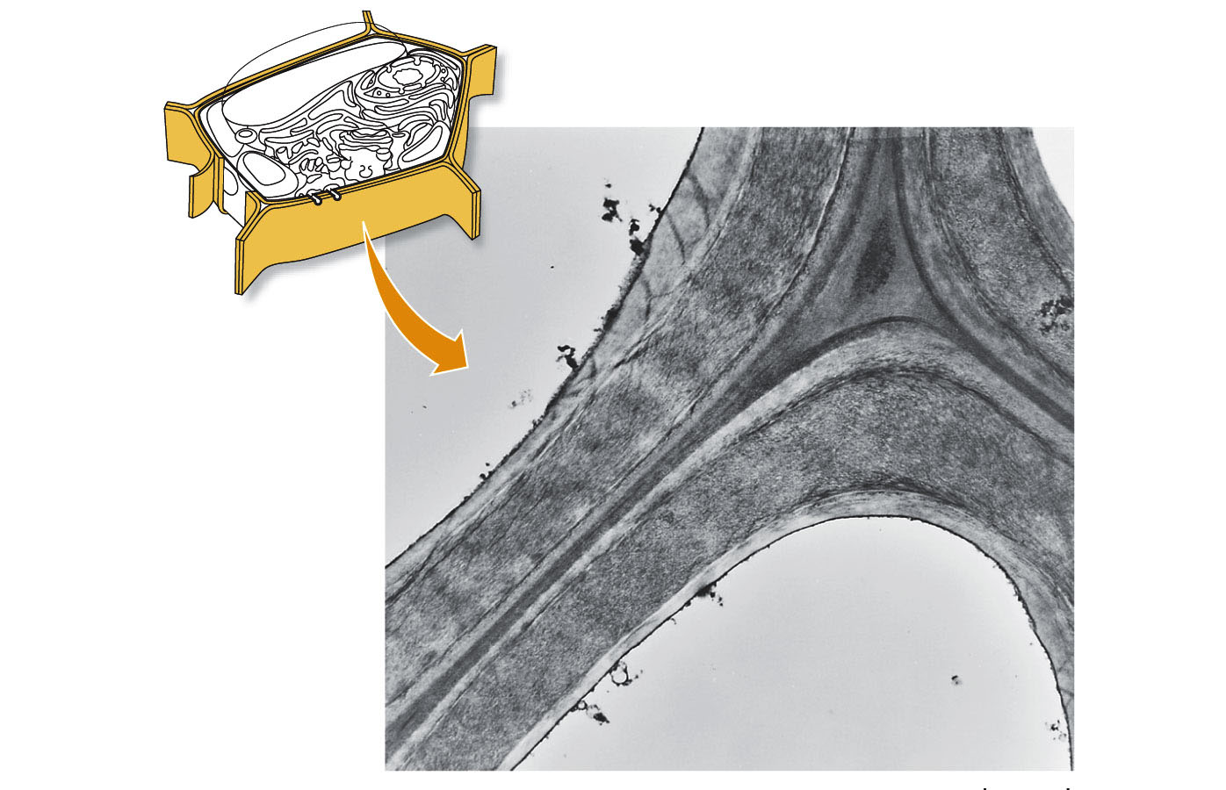
Intro to Biotechnology
Lect. 2
Eukaryotic cells – differences
3. ECM vs cell wall

